Slide 1
Visualizing High Dimensional Data
David E. Rosenberg
CEE6410

Slide 2

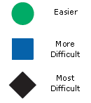

Learning Objectives
Recognize the dimensionality of a data plot
Increase the dimensionality of Cartesian plots
  Use color to illustrate one or more data attributes
Create parallel coordinate plots that simultaneously show as many data dimensions as you need!

Slide 3
Today’s Overarching Question
How many dimensions (objectives and decision variables) can you show on a single plot?
Field 1 | Field 2 | Field 3 | … | Field N
: | : | : |  | :
Alternative 1
Alternative 2
Alternative 3
:
Alternative M
David Rosenberg
<number>

Slide 4
Part I
Recognize the dimensionality (number of attributes) on a plot

Slide 5
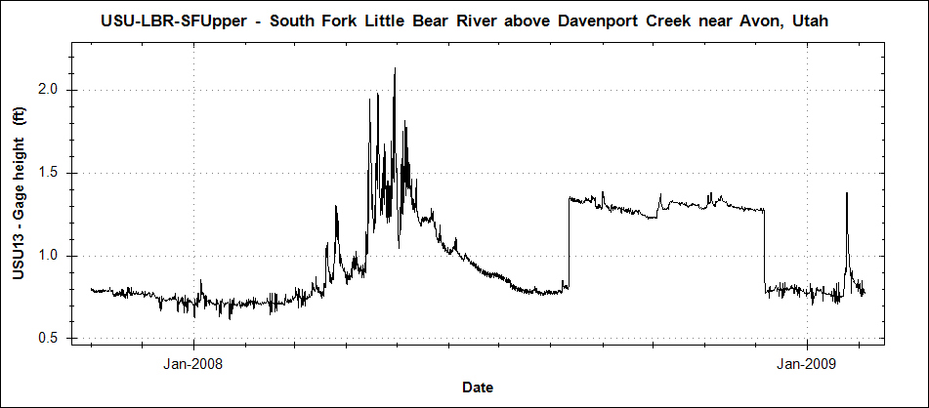
Example 1. How many attributes are plotted?
Gage height
Date/Time
David Rosenberg
<number>

Slide 6
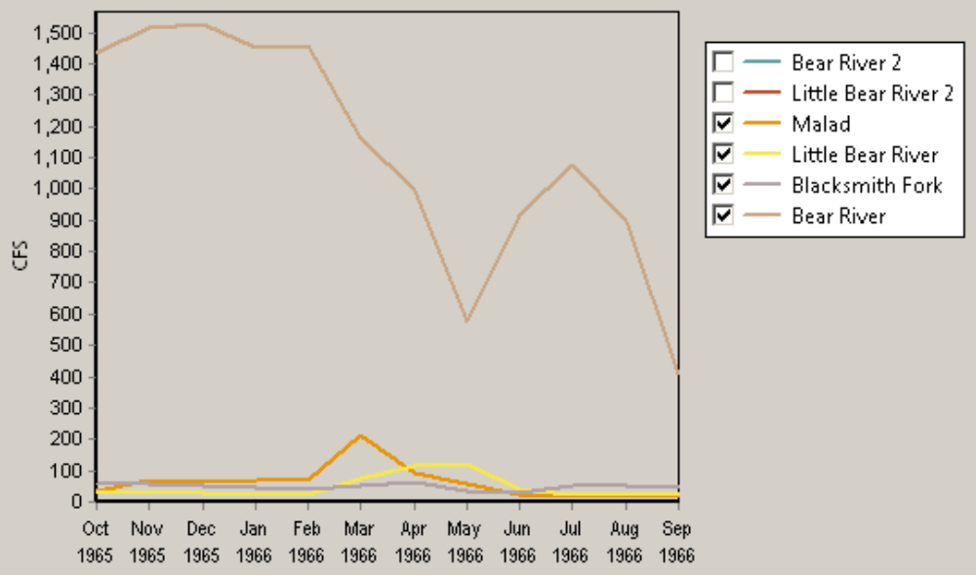
Example 2. How many attributes are plotted?
Month/Year
Flow
Location
David Rosenberg
<number>

Slide 7
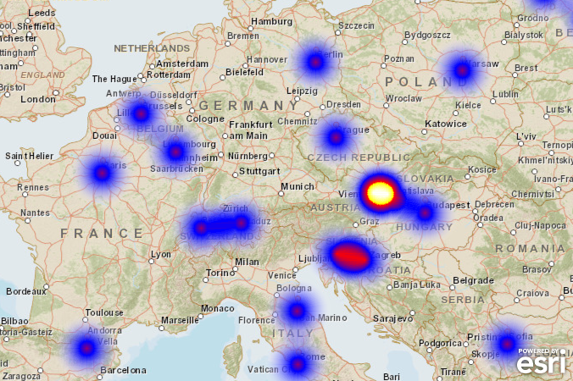
Example 3. How many data attributes are plotted?
Latitude
Longitude
Something (color)
David Rosenberg
<number>

Slide 8
Part II
Increase the dimensionality (number of attributes) on a plot

Slide 9



Plot tools to represent data attributes
Plot Tool | Attribute type | Value range | Examples
X axis | Scalar/Categorical | -∞ to ∞
Y axis | Scalar/Categorical | -∞ to ∞
Z axis (projected) | Scalar/Categorical | -∞ to ∞
Marker type | Categorical | A few
Line style | Categorical | A few
Line thickness | Scalar | 0 to ∞
Marker size | Scalar | 0 to ∞
Marker orientation | Scalar | -∞ to ∞
Color – ascending | Scalar | 0 to ∞
Color – diverging | Scalar | -∞ to ∞
Color – categorical | Categorical | A, B, C, ...
z
y
x
David Rosenberg
<number>

Slide 10
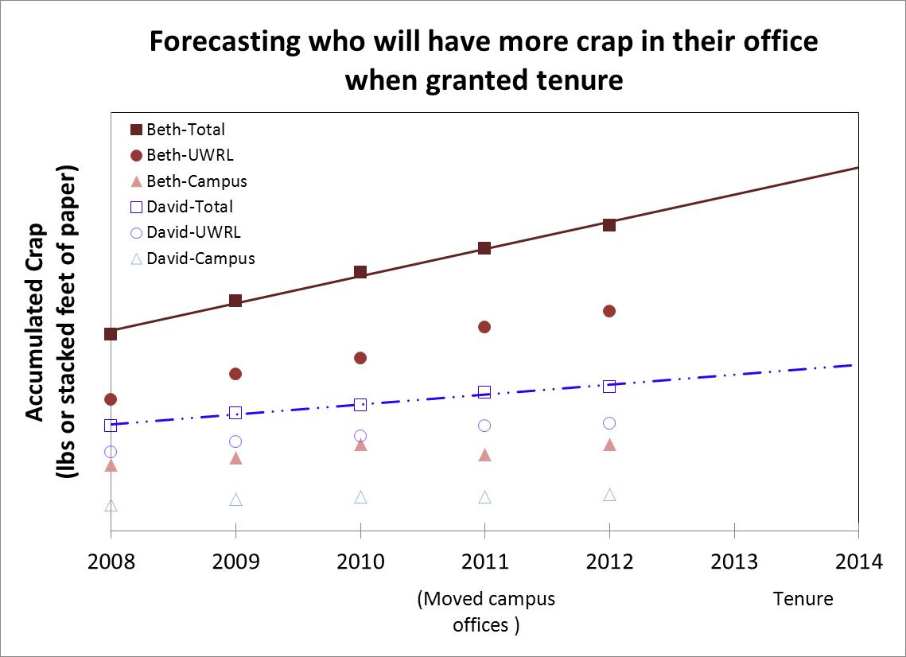
Year – axis #1
Crap – axis #2
Location – marker type
Person – color and marker fill
David Rosenberg
<number>

Slide 11
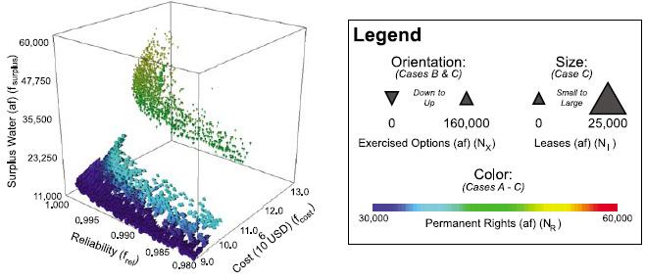
Example 5. What attributes and tools are plotted and used?
Cost – axis #1
Reliability – axis #2
Surplus water – axis #3
Marker orientation – exercised options
Marker size – leases
Color – permanent rights
Kasprzyk et al. (2009)
AeroVis software: https://www.decisionvis.com/
David Rosenberg
<number>

Slide 12
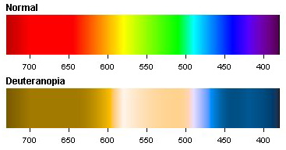
Use Colors that…
Color-deficient viewers can resolve!
  7 to 10% of men suffer
  Avoid greens and reds
Print well in black & white
Associate and ramp according to the categorical or scalar nature of the attribute
Follow the OSU color schemes for scientific data graphics;
  Matlab implementation
Avoid Matlab, ArcGIS, Excel, etc. default schemes
No! No! No! No!
David Rosenberg
<number>

Slide 13
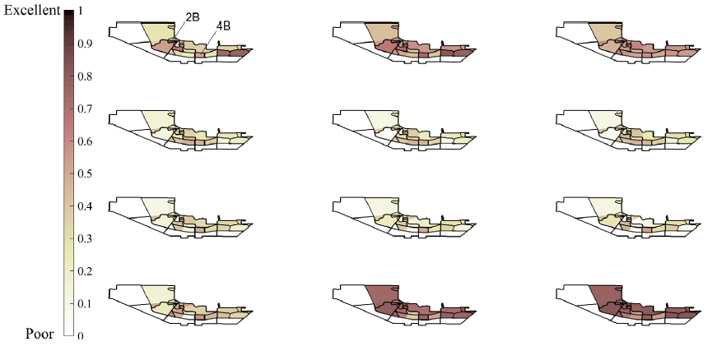
Example Sequential Color Ramp
Composite Habitat Suitability at Bear River Migratory Bird Refuge
January
February
March
Composite Habitat Suitability
April
May
June
July
August
September
October
November
December
Alminagorta et al (2016)
David Rosenberg
<number>

Slide 14
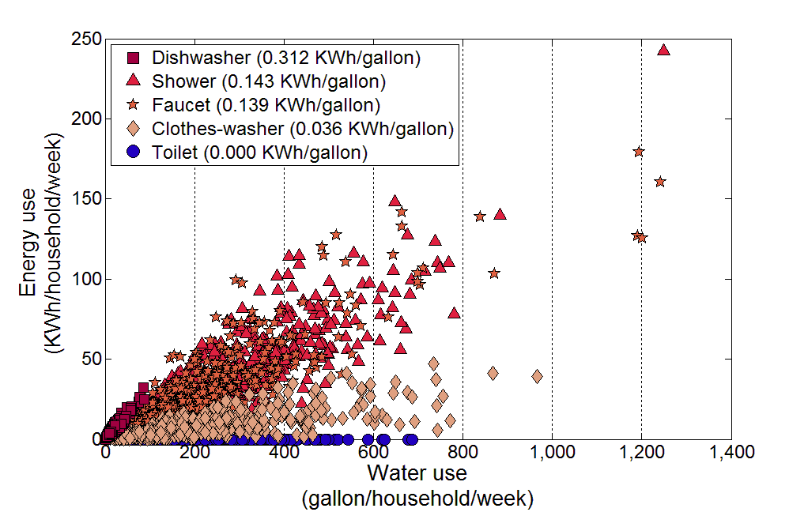
Example Diverging Color Ramp
Energy-Water Appliance Intensity: Salt Lake City, Utah
Abdallah and Rosenberg (2014)
David Rosenberg
<number>

Slide 15

Good Color Reads
Lisa Charlotte Rost (2020). “How to pick more beautiful colors for your data visualizations.” https://blog.datawrapper.de/beautifulcolors/
Lisa Charlotte Rost (2020). “How your colorblind and colorweak readers see your colors.” (3 parts) https://blog.datawrapper.de/colorblindness-part1/

Slide 16
Further Tips to Plot Multiple Attributes
Check view angle on 3-axes plots (3rd axis may hide data)
Remove data to reduce plot clutter/smearing
Introduce a plot by describing every attribute plotted
Avoid matrix plots in oral presentations
  They are (unfortunately) fashionable
  Your audience rarely understands single plots let alone 4 (or 8 or 16!) crammed onto a single slide
You take hours, days, or weeks to prepare a plot…
  The reader must digest the key message in ~ 15 seconds!
David Rosenberg
<number>

Slide 17
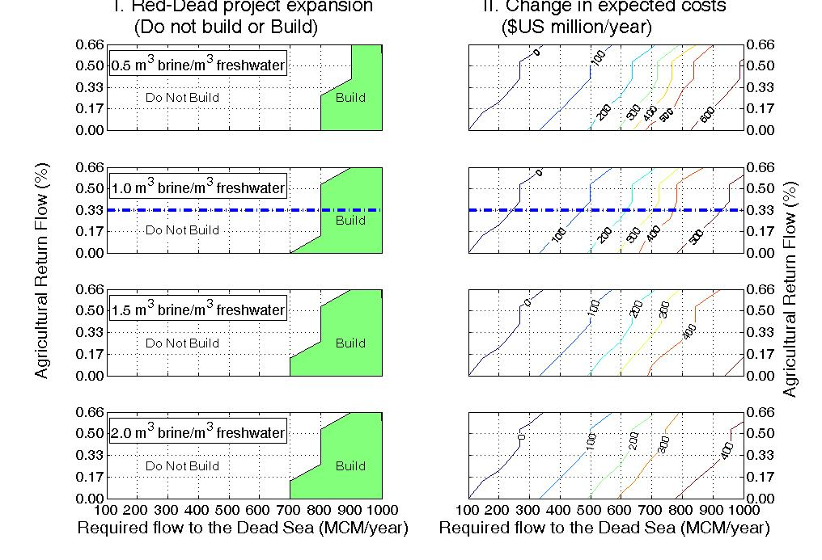
Don’t show a matrix plot like this in a presentation!!

Slide 18
Part III
Use parallel coordinates to plot as many attributes as you need
(Wegman, 1990)

Slide 19
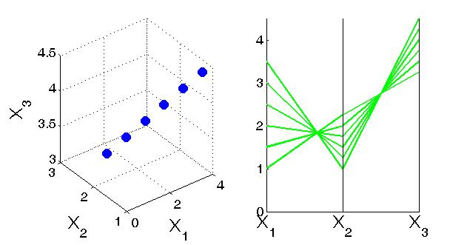
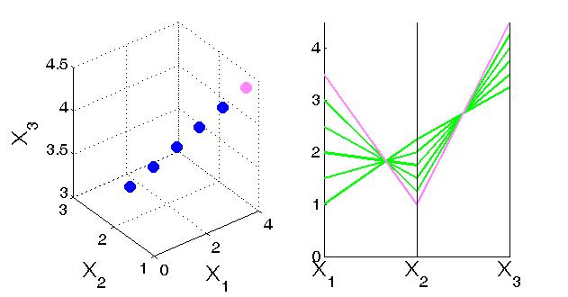
Parallel Coordinate Visualization
Plot axes parallel rather than orthogonally
Point, line, curve, etc. concepts map
Accommodate much larger # of dimensions
Cartesian
Parallel

Slide 20
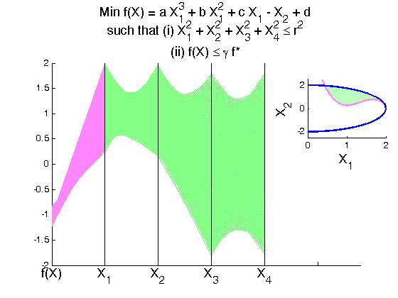
4-dimensional hypersphere cut by a
2-dimensional non-linear surface

Slide 21
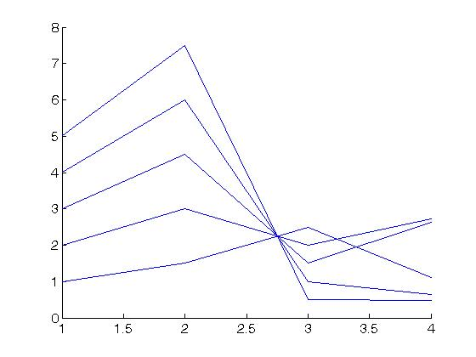
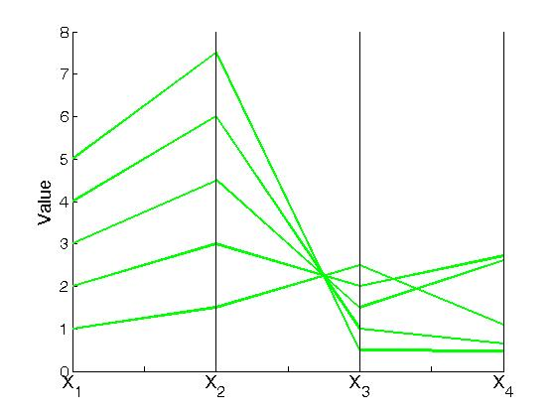
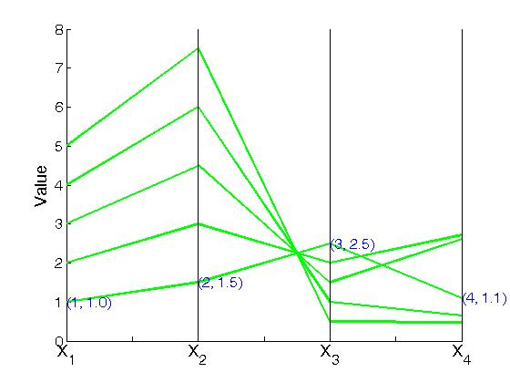
Prepare a Parallel Coordinate Plot
Organize the data
Matlab: parallelcoords(X)
  X is your matrix
Excel: line plot
Annotate to label the axes
X₁ | X₂ | X₃ | X₄
1 | 1.5 | 2.5 | 1.76
2 | 3 | 2 | 1.52
3 | 4.5 | 1.5 | 2.06
4 | 6 | 1 | 3.18
5 | 7.5 | 0.5 | 0.75

Slide 22
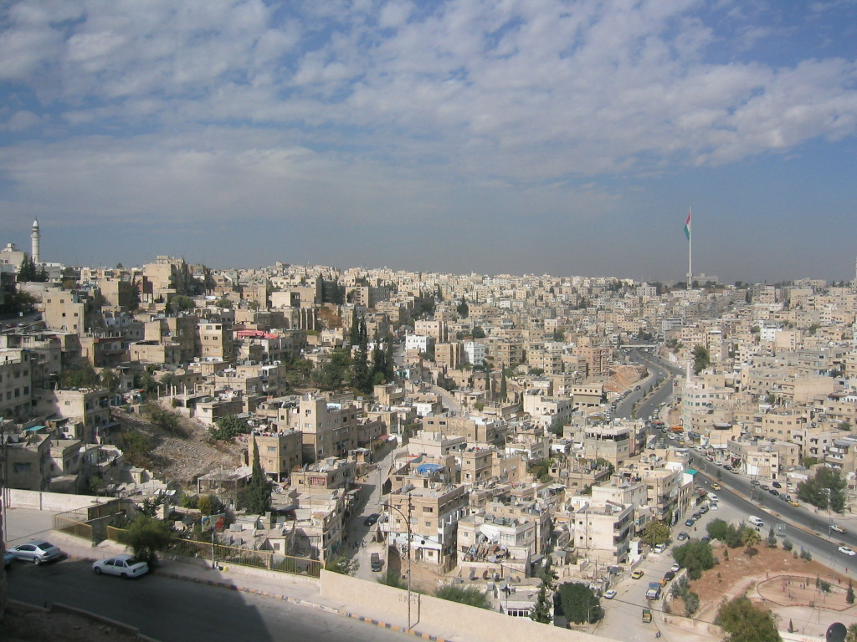
Application #1. Parallel coordinates to inform water planning in
Amman, Jordan

Slide 23
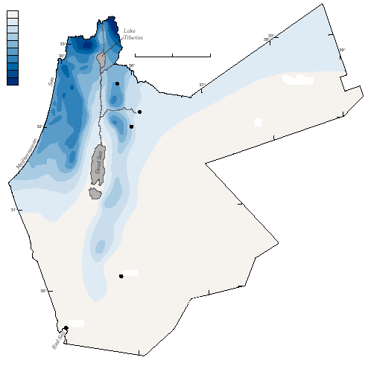
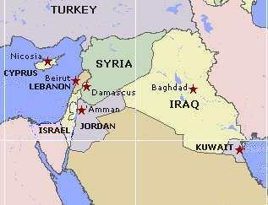
Amman Water Overview
100 mm/yr
500
900
0 50 100 km
Irbid
Zarka
2+ mill. people
133 Mm³/yr supplies
Water available for 12–60 hrs/wk
Amman
Israel / Palestine
Jordan
Ma’an
IRAN
PAL.
Aqaba
EGYPT
SAUDI ARABIA
Red Sea

Slide 24
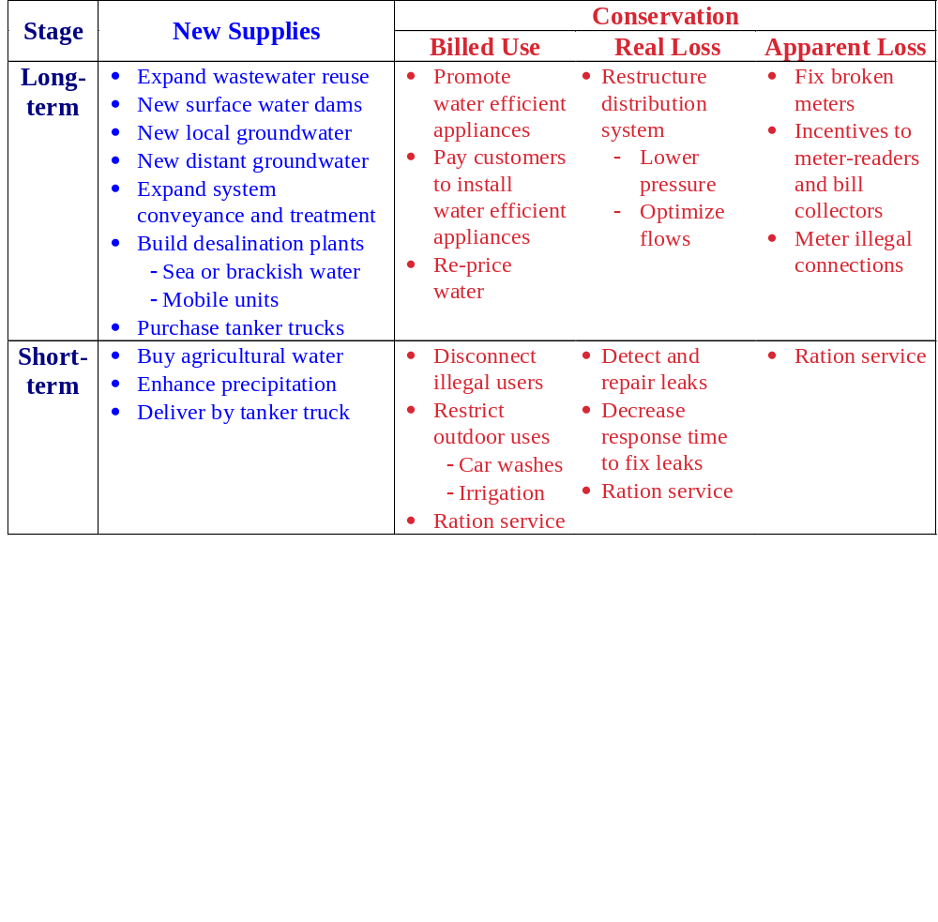
23 potential city-level actions
David Rosenberg
<number>

Slide 25
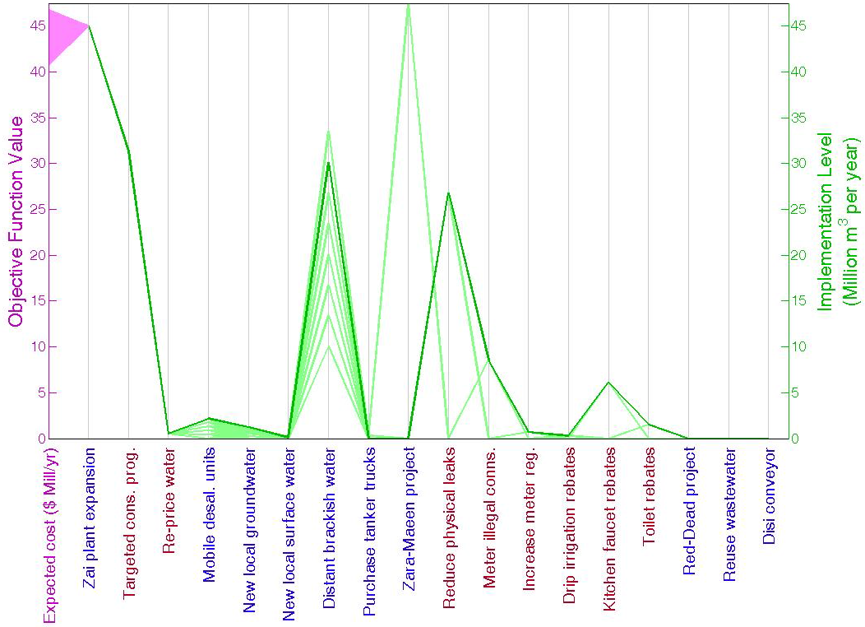

Optimal solution and near-optimal region

Slide 26
Wrap Up
Identify the data attributes (dimensions) on a plot
Show data attributes with axes, marker and line types, size and thickness, and marker orientation
Apply diverging, sequential, categorical, and stepped-sequential color schemes appropriate to the attribute type and value range
Plot in parallel coordinates to show much larger numbers of attributes
David Rosenberg
<number>

Slide 27
References
Abdallah, A., and Rosenberg, D. (2014). "Heterogeneous Residential Water and Energy Linkages and Implications for Conservation and Management." Journal of Water Resources Planning and Management - ASCE, 140(3), 288-297. http://ascelibrary.org/doi/abs/10.1061/%28ASCE%29WR.1943-5452.0000340.
Alminagorta, O., Rosenberg, D. E., and Kettenring, K. M. (2016). "Systems modeling to improve the hydroecological performance of diked wetlands." Water Resources Research, 52(9), 7070–7085. http://dx.doi.org/10.1002/2015WR018105.
Kasprzyk et al. (2009). "Managing population and drought risks using many-objective water portfolio planning under uncertainty." Water Resources Research, 45(12), W12401. http://dx.doi.org/10.1029/2009WR008121.
Rosenberg (2011). "Raising the Dead without a Red Sea-Dead Sea project? Hydro-economics and governance." Hydrology and Earth System Sciences, 15(6), 1243-1255. http://www.hydrol-earth-syst-sci.net/15/1243/2011/hess-15-1243-2011.html.
David Rosenberg
<number>

Slide 28
References (cont.)
Color Schemes Appropriate for Scientific Data Graphics (2007). Oregon State University, Department of Geography. http://geog.uoregon.edu/datagraphics/color_scales.htm.
Singer, Y. (2009). "Network visulization and analysis with parallel coordinates." Parallel Coordinates: visual multidimensional geometry and its applications, A. Inselberg, ed., Springer, New York, 460-475.
Wegman, E. J. (1990). "Hyperdimensional Data Analysis Using Parallel Coordinates." Journal of the American Statistical Association, 85(411), 664-675. http://www.jstor.org/stable/2290001
David Rosenberg
<number>

